Slide 1
Using WordPress to Contextualize and Publish Digital Repository Content

Slide 2
Our Question(s)
How can we represent the longevity and sustainability of digital humanities research projects as a shared responsibility that begins with fundamental project design decisions and data creation strategies, rather than purely an obligation of the library?
And how can we create a culture of partnership among faculty and student researchers and library staff, in which the challenges of digital curation are understood as shared research challenges rather than functional details of purely “technical” implementation?

Slide 3
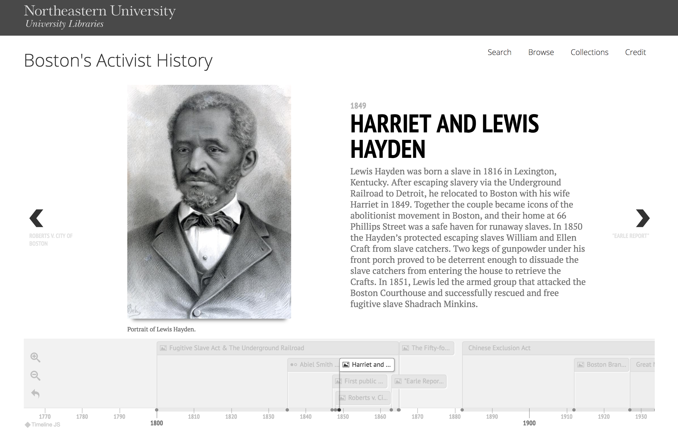
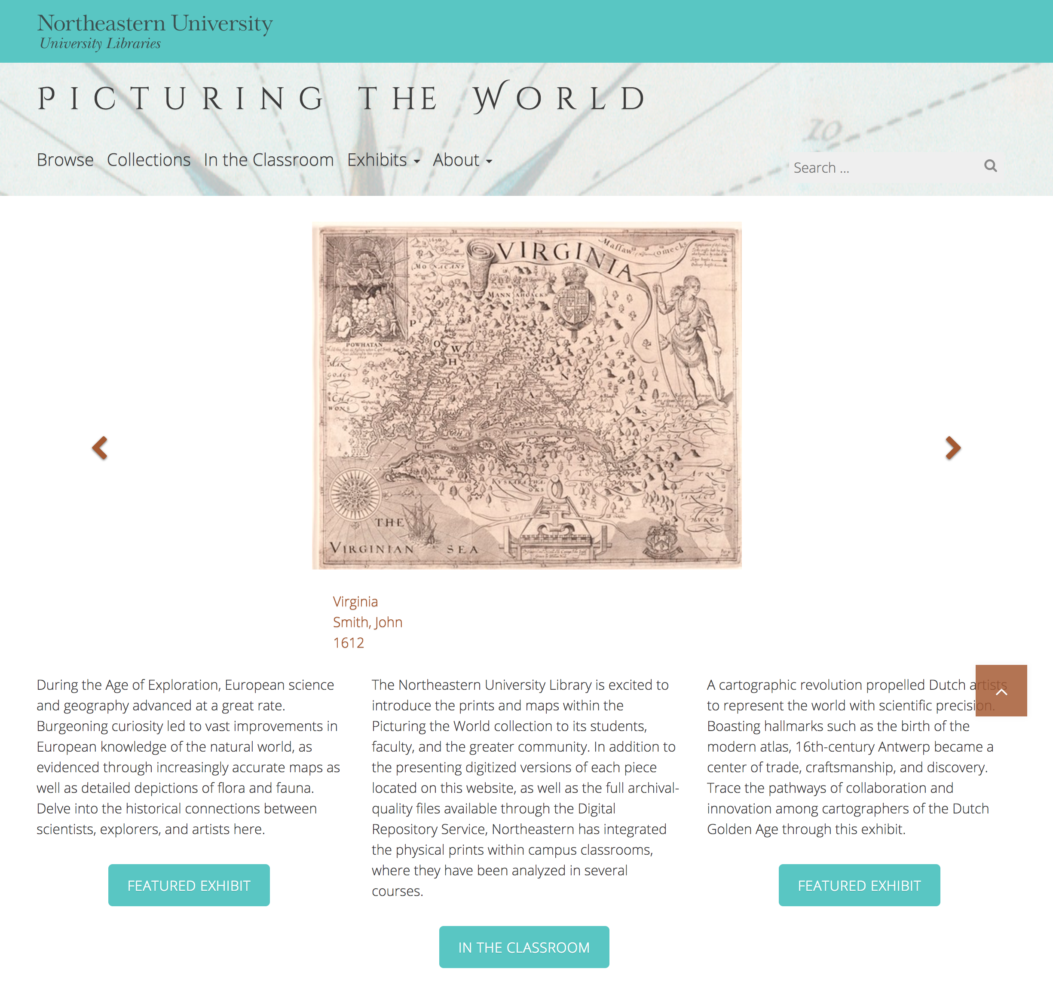
Our Answer
The Community Enhanced Repository for Engaged Scholarship: CERES

Slide 4
Collaborative Development Principles
Support systems, not individual projects.
Materials should be curatable and usable.
Development is a shared research undertaking.

Slide 5
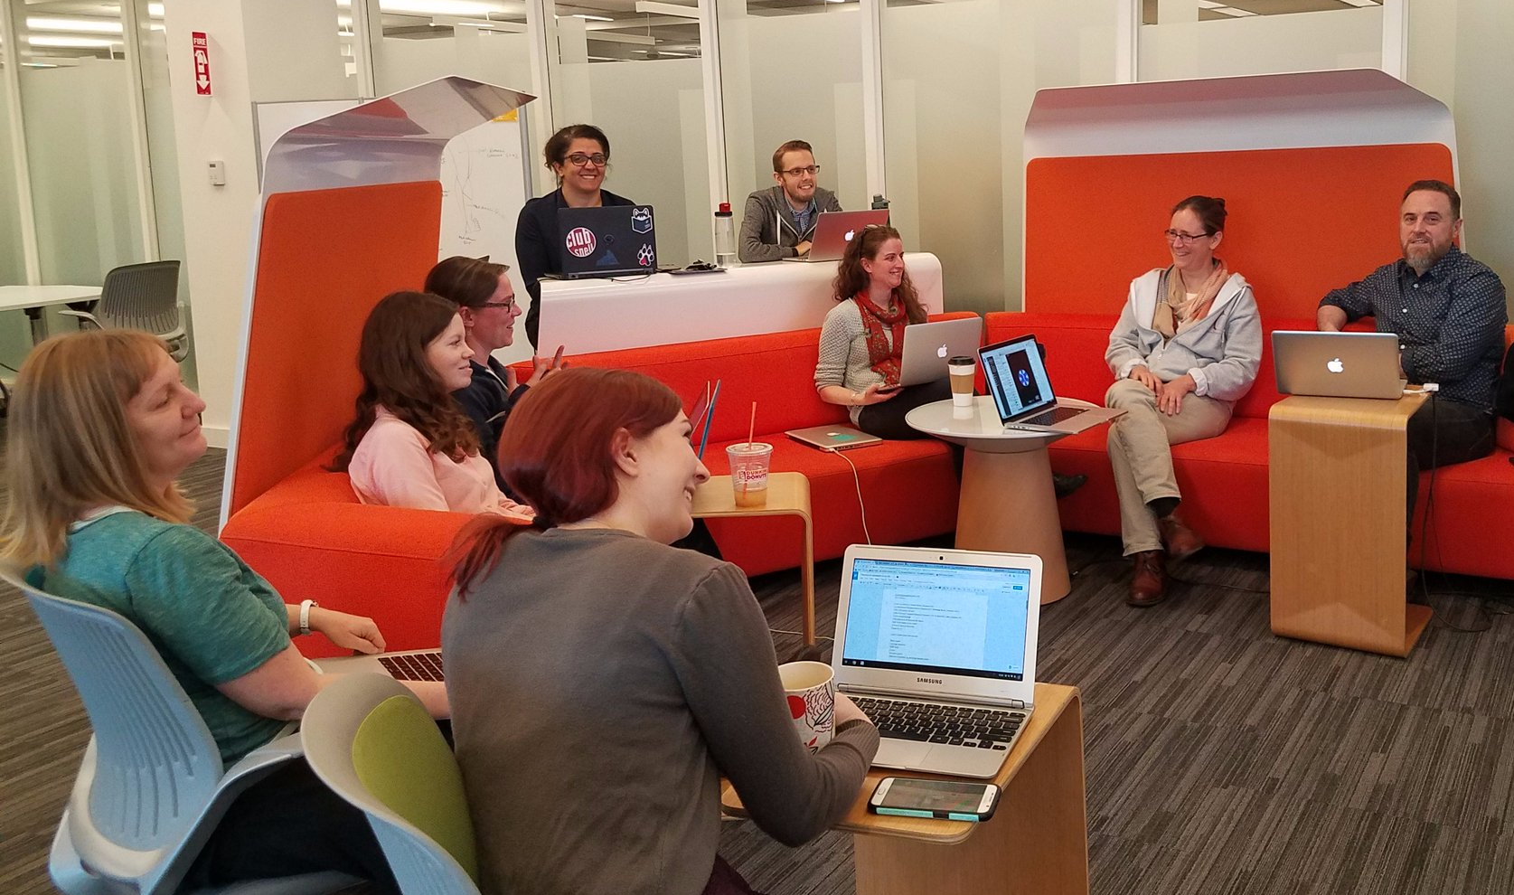
Who We Are
Northeastern University Libraries, Digital Scholarship Group
Text analysis and encoding
GIS
Data visualization
Data management
Repository services
Copyright guidance
Semantic web services

Slide 6



